Slide 1
Lecture 5.0 Shortest Paths
Department of Computer Science
Hofstra University

Slide 2
Lecture Goals
In this lecture we study shortest-paths problems. We begin by analyzing some basic properties of shortest paths and a generic algorithm for the problem.
We introduce and analyze Dijkstra's algorithm for shortest-paths problems with nonnegative weights.
Next, we consider Topological Sort for Edge-weighted DAG, which works even if the weights are negative.
We conclude with the Bellman–Ford algorithm for edge-weighted digraphs with no negative cycles.
We conclude with the Floyd Warshall Algorithm for all-pairs shortest path

Slide 3
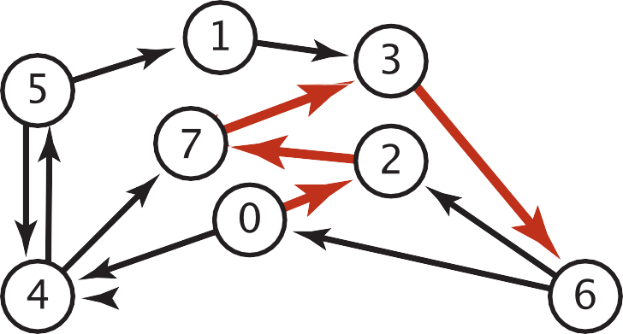
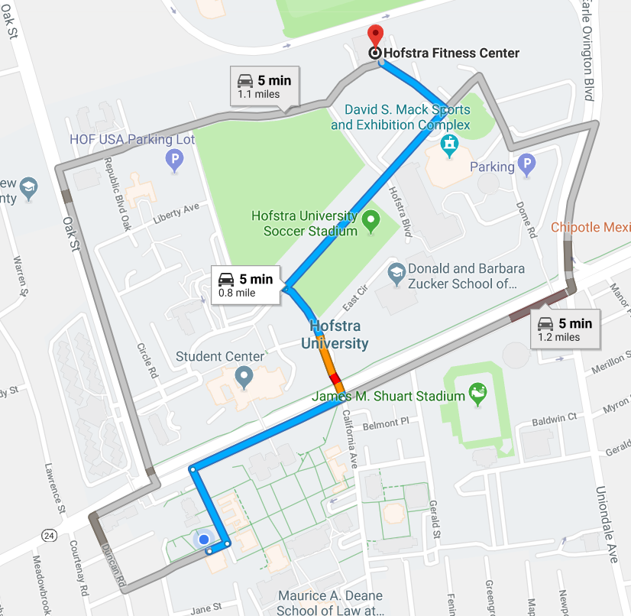

Shortest Paths in an Edge-weighted Digraph
Given an edge-weighted digraph, find the shortest path from s to t.
edge-weighted digraph
shortest path from 0 to 6
0->2 0.26
4->5 | 0.35
5->4 | 0.35
4->7 | 0.37
5->7 | 0.28
7->5 | 0.28
5->1 | 0.32
0->4 | 0.38
0->2 | 0.26
7->3 | 0.39
1->3 | 0.29
2->7 | 0.34
6->2 | 0.40
3->6 | 0.52
6->0 | 0.58
6->4 | 0.93
2->7 | 0.34
7->3 | 0.39
3->6 | 0.52
Variants
Can we use BFS?
Which vertices?
Single source: from one vertex s to every other vertex.
Source-sink: from one vertex s to another t.
All pairs: between all pairs of vertices.
Nonnegative weights?
Cycles?
Negative cycles.
Simplifying assumption: Each vertex is reachable from s.

Slide 4
Weighted Directed Edge API
public class DirectedEdge
DirectedEdge(int v, int w, double weight) //weighted edge v->w
int from() // vertex v
int to() // vertex w
double weight() // the weight
String toString() // string representation
weight
v
w
Idiom for processing an edge e: int v = e.from(), w = e.to();

Slide 5

Weighted Edge: Java Implementation
public class DirectedEdge
{
private final int v, w; private final double weight;
public DirectedEdge(int v, int w, double weight)
{
this.v = v; this.w = w;
this.weight = weight;
}
public int from()
{ return v; }
public int to()
{ return w; }
public int weight()
{ return weight; }
}

Slide 6
Edge-Weighted Graph API
public class EdgeWeightedDigraph
EdgeWeightedDigraph(int V) // edge-weighted digraph with V vertices
void addEdge(DirectedEdge e) // add weighted directed edge e
Iterable <DirectedEdge> adj(int v) // edges pointing from v
Iterable <DirectedEdge> edges() // all edges in this graph
int V() // number of vertices
int E() // number of edges
String toString() // string representation
0 | 2 | .26 | →
0 | 1 | .38
adj
0
1
2
3
4
1 | 3 | .29
2 | 4 | .34
reference to a
DirectedEdge
object
3 | 2 | .52
4 | 2 | .26 | →
4 | 0 | .35

Slide 7

Edge-Weighted Digraph: Adjacency-Lists Implementation
public class EdgeWeightedDigraph
{
private final int V;
private final List<DirectedEdge>[] adj;
public EdgeWeightedDigraph (int V)
{
this.V = V;
adj = (List<DirectedEdge>[]) new ArrayList[V];
for (int v = 0; v < V; v++)
adj[v] = new ArrayList<DirectedEdge>();
}
public void addEdge(DirectedEdge e)
{
int v = e.from();
adj[v].add(e);
}
add edge e = v->w to only v’s adjacency lists
public Iterable<DirectedEdge> adj(int v)
{ return adj[v]; }
}

Slide 8

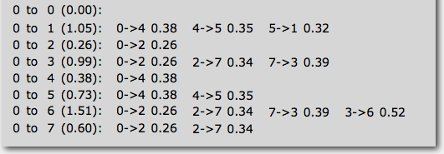
Single-source Shortest Paths API
Goal. Find the shortest path from s to every other vertex.
public class SP
SP(EdgeWeightedGraph G, int s) // shortest paths from s in graph G
double distTo(int v) // length of shortest path from s to v
Iterable <DirectedEdge> pathTo(int v) // shortest path from s to v
SP sp = new SP(G, s);
for (int v = 0; v < G.V(); v++)
{
StdOut.printf("%d to %d (%.2f): ", s, v, sp.distTo(v));
for (DirectedEdge e : sp.pathTo(v)) {
StdOut.print(e + " ");
StdOut.println();
}
}

Slide 9
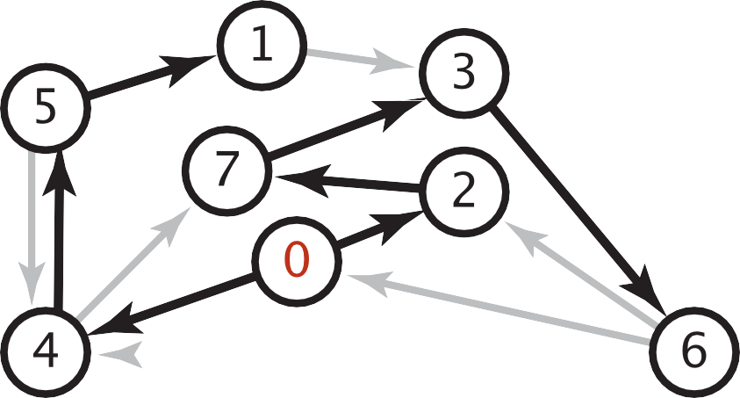

Data Structures for Single-source Shortest Paths
Goal. Find the shortest path from s to every other vertex.
Observation. A shortest-paths tree (SPT) solution exists.
Consequence. Can represent the SPT with two vertex-indexed arrays:
distTo[v] is length of shortest path from s to v.
edgeTo[v] is last edge on shortest path from s to v.
shortest-paths tree from 0
edgeTo[]
distTo[]
public double distTo(int v)
{ return distTo[v]; }
0
1
2
3
4
5
6
7
null 0
5->1 0.32 1.05
0->2 0.26 0.26
7->3 0.37 0.97
0->4 0.38 0.38
4->5 0.35 0.73
3->6 0.52 1.49
2->7 0.34 0.60
public Iterable<DirectedEdge> pathTo(int v)
{
Stack<DirectedEdge> path = new Stack<DirectedEdge>();
for (DirectedEdge e = edgeTo[v]; e != null; e = edgeTo[e.from()])
path.push(e);
return path;
}
parent-link representation

Slide 10

Edge Relaxation
Relax edge e = v→w. (basic of building SPT)
distTo[v] is length of shortest known path from s to v.
distTo[w] is length of shortest known path from s to w.
edgeTo[w] is last edge on shortest known path from s to w.
If e = v→w gives shorter path to w through v, update distTo[w] and edgeTo[w].
distTo[w] = min(distTo[w], distTo[v] + e.weight());
private void relax(DirectedEdge e)
{
int v = e.from(), w = e.to();
if (distTo[w] > distTo[v] + e.weight())
{
distTo[w] = distTo[v] + e.weight();
edgeTo[w] = e;
}
}
edgeTo[w] = v
relax edge v→w
3.1
v
1.3
s
w
7.2
black edge are in edgeTo[ ]
OLD distTo[w] = 7.2 > distTo[v] + e.weight()
= 3.1+1.3 = 4.4
NEW distTo[w] ← distTo[v] + e.weight() = 4.4

Slide 11
Generic Shortest-paths Algorithm
Generic algorithm (to compute SPT from s)
For each vertex v: distTo[v] = ∞.
For each vertex v: edgeTo[v] = null.
distTo[s] = 0.
Repeat until done:
- Relax any edge.
Proposition. Generic algorithm computes SPT (if it exists) from s.
Pf.
Throughout algorithm, distTo[v] is the length of a simple path from s to v (and edgeTo[v] is last edge on path).
Each successful relaxation decreases distTo[v] for some v.
The entry distTo[v] can decrease at most a finite number of times.
Efficient implementations. How to choose which edge to relax?
Ex 1. Dijkstra’s algorithm. (nonnegative weights, directed cycles).
Ex 2. Bellman–Ford algorithm. (no negative cycles).
Notes:
Ex 2. Topological sort algorithm. (no directed cycles).

Slide 12
Dijkstra's Algorithm
Initialization:
Set the distance to the source node as 0 and to all other nodes as infinity.
Mark all nodes as unvisited and store them in a priority queue.
Main Loop:
Extract the unvisited node with the smallest known distance from the queue.
For each neighboring node, calculate its tentative distance through the current node. If this distance is smaller than the previously recorded distance, update it with relaxation.
Mark the current node as visited once all its neighbors are processed.
Termination:
The algorithm continues until all reachable nodes are visited, or until the shortest path to a specific destination is found.

Slide 13
Dijkstra’s Algorithm: Correctness Proof
Proposition. Dijkstra's algorithm computes a SPT in any edge-weighted digraph with nonnegative weights.
Pf.
Each edge e = v→w is relaxed exactly once (when v is relaxed),
leaving distTo[w] ≤ distTo[v] + e.weight().
Inequality holds until algorithm terminates because:
distTo[w] cannot increase
distTo[v] will not change
Thus, upon termination, shortest-paths optimality conditions hold.
distTo[ ] values are monotone decreasing
we choose lowest distTo[ ] value at each step (and edge weights are nonnegative)

Slide 14
Video Tutorials
Dijkstras Shortest Path Algorithm Explained | With Example | Graph Theory
https://www.youtube.com/watch?v=bZkzH5x0SKU
The following lecture slides are based on this video
Dijkstra's algorithm in 3 minutes
https://www.youtube.com/watch?v=_lHSawdgXpI
Bellman-Ford in 4 minutes — Theory
https://www.youtube.com/watch?v=9PHkk0UavIM
Bellman-Ford in 5 minutes — Step by step example
https://www.youtube.com/watch?v=obWXjtg0L64

Slide 15
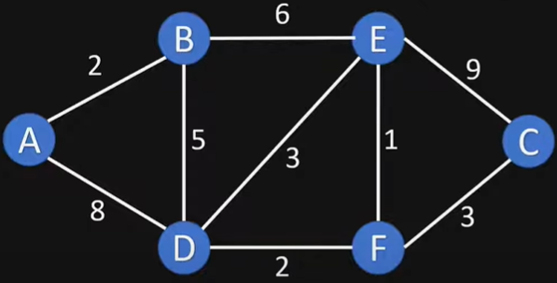
Example Graph

Slide 16
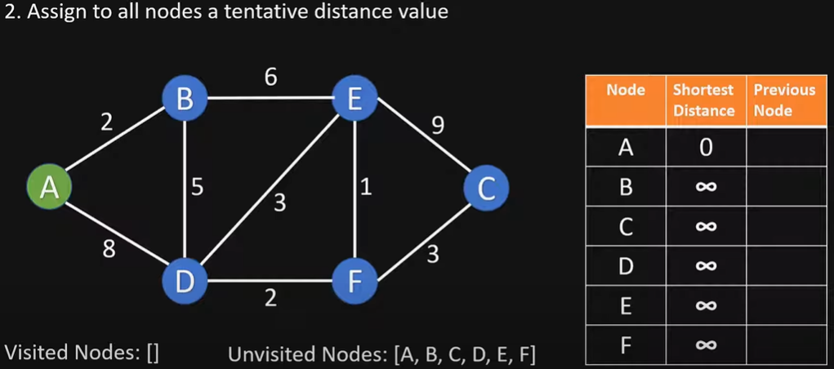
Initialize

Slide 17
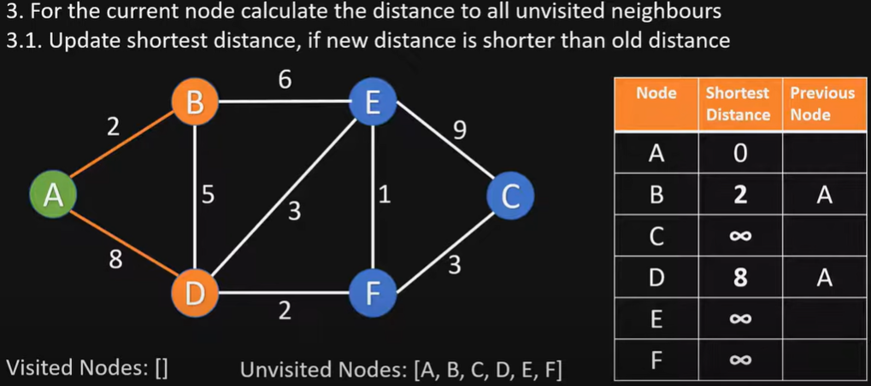
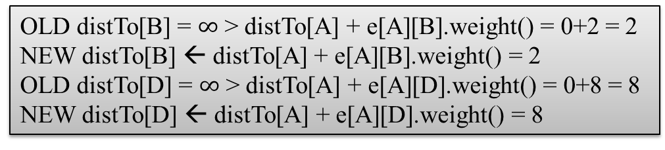
Visit Node A
OLD distTo[B] = $∞$ > distTo[A] + e[A][B].weight() = 0+2 = 2
NEW distTo[B] ← distTo[A] + e[A][B].weight() = 2
OLD distTo[D] = $∞$ > distTo[A] + e[A][D].weight() = 0+8 = 8
NEW distTo[D] ← distTo[A] + e[A][D].weight() = 8

Slide 18
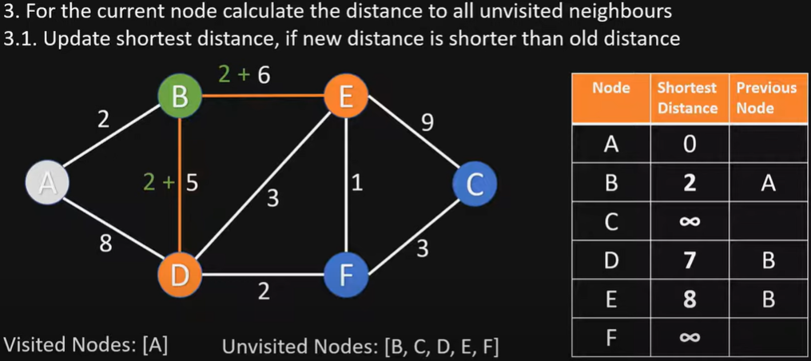
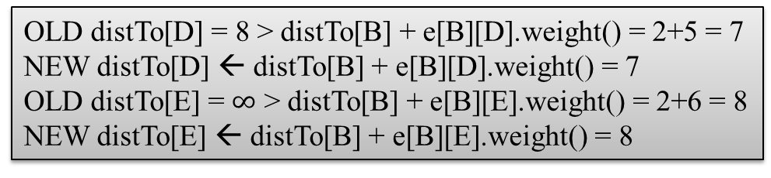
Visit Node B
OLD distTo[D] = 8 > distTo[B] + e[B][D].weight() = 2+5 = 7
NEW distTo[D] ← distTo[B] + e[B][D].weight() = 7
OLD distTo[E] = $∞$ > distTo[B] + e[B][E].weight() = 2+6 = 8
NEW distTo[E] ← distTo[B] + e[B][E].weight() = 8

Slide 19
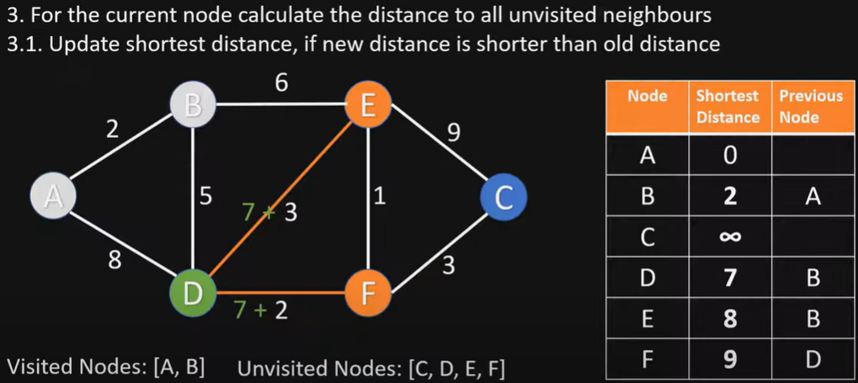
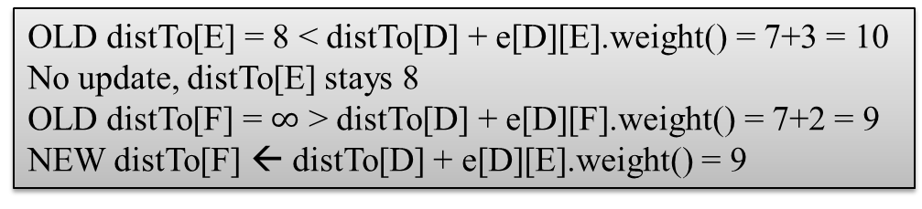
Visit Node D
OLD distTo[E] = 8 < distTo[D] + e[D][E].weight() = 7+3 = 10
No update, distTo[E] stays 8
OLD distTo[F] = $∞$ > distTo[D] + e[D][F].weight() = 7+2 = 9
NEW distTo[F] ← distTo[D] + e[D][E].weight() = 9

Slide 20
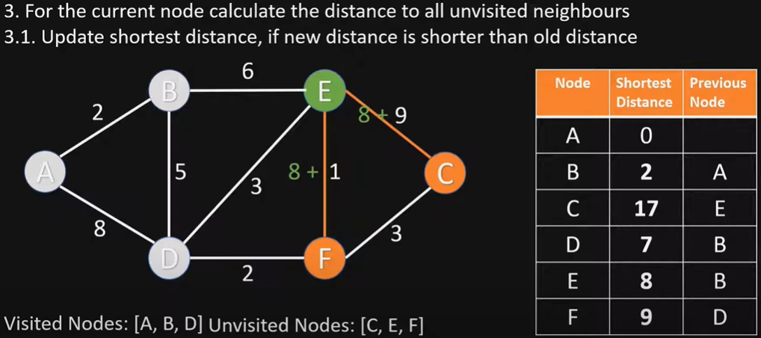
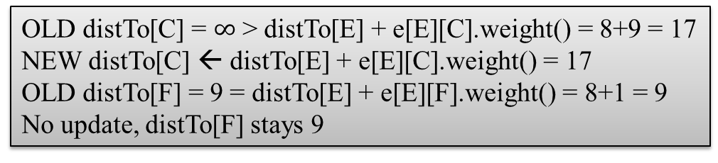
Visit Node E
OLD distTo[C] = $∞$ > distTo[E] + e[E][C].weight() = 8+9 = 17
NEW distTo[C] ← distTo[E] + e[E][C].weight() = 17
OLD distTo[F] = 9 = distTo[E] + e[E][F].weight() = 8+1 = 9
No update, distTo[F] stays 9

Slide 21
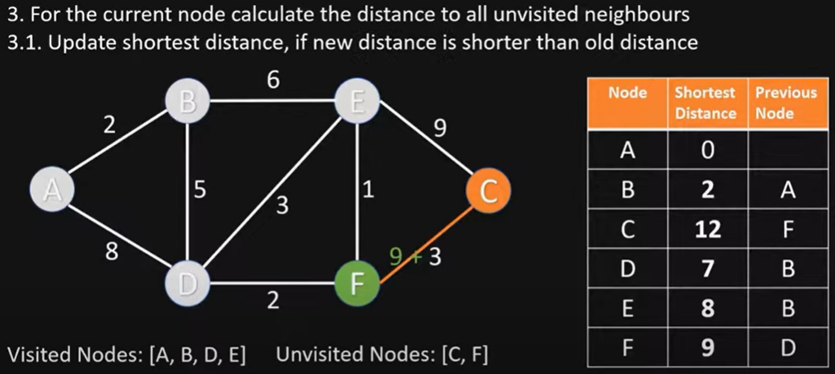
Visit Node F
OLD distTo[C] = 17 > distTo[F] + e[F][C].weight() = 9+3 = 12
NEW distTo[C] ← distTo[F] + e[F][C].weight() = 12

Slide 22
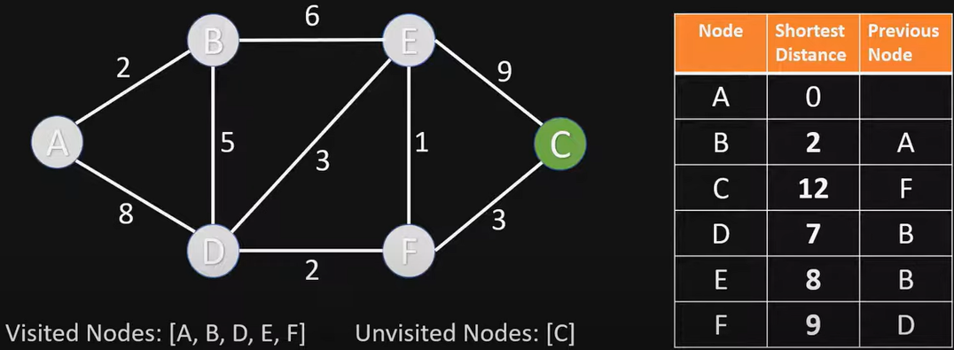
Visit Node C
Nothing changes, since C has no unvisited neighbor nodes

Slide 23
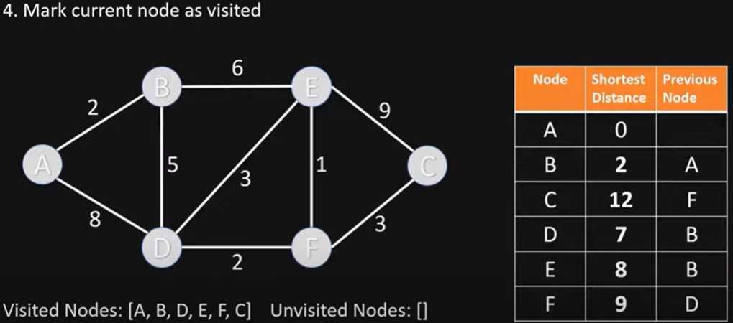
End of Algorithm
Table contains the shortest distance to each node N from the source node A, and its previous node in the shortest path

Slide 24
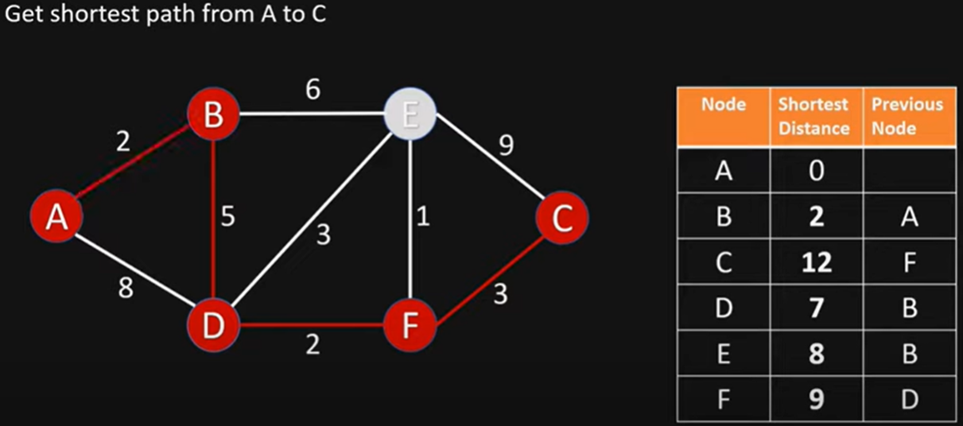
Getting the Shortest Path from A to C
C’s previous node is F; F’s previous node is D; D’s previous node is B; B’s previous node is A
Shortest Path from A to C is ABDFC

Slide 25
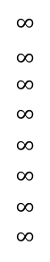
Dijkstra’s Algorithm Example 2
choose vertex 5
relax all edges adjacent from 5
choose vertex 2
relax all edges adjacent from 2
choose vertex 3
relax all edges adjacent from 3
choose vertex 6
relax all edges adjacent from 6
Consider vertices in increasing order of distance from s
(non-tree vertex with the lowest distTo[ ] value).
Add vertex to tree and relax all edges pointing from that vertex.
1
v distTo[]
15
3
$$∞$$
$∞$ $∞$
$$∞$$
$$∞$$
$$∞$$
$$∞$$
$$∞$$
0
5
17
20
9
14
29
8
15
17
13
26
14
25
0
1
2
3
4
5
6
7
5
4
12
0
3
8
7
2
7
9
9
5
6
1
5
11
v edgeTo[]
4
4
13
6
0
1
2
3
4
5
6
7
-
-
-
-
-
-
-
-
0
1
1
0
7
4
0
7
2
4
5
5
2
20
choose source vertex 0
relax all edges adjacent from 0
choose vertex 1
relax all edges adjacent from 1
choose vertex 7
relax all edges adjacent from 7
choose vertex 4
relax all edges adjacent from 4

Slide 26
Dijkstra’s Algorithm Example 3
3
B
D
3
1
A
1
2
1
C
E
4
Notes:
David Kauchak
cs161
Summer 2009
Graphs: MSTs and Shortest Paths https://cs.pomona.edu/~dkauchak/classes/algorithms/

Slide 27
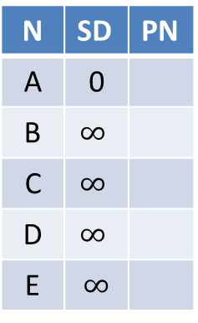
Initialize
∞
∞
3
N | SD | PN
A | 0
B | $$∞$$
C | $$∞$$
D | $$∞$$
E | $$∞$$
B
D
3
0
1
A
1
2
∞
1
C
E
∞
4

Slide 28
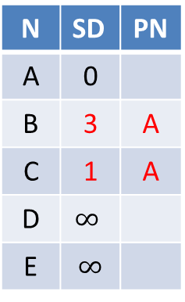
Visit Node A
3
∞
3
N | SD | PN
A | 0
B | 3 | A
C | 1 | A
D | $$∞$$
E | $$∞$$
B
D
3
0
1
A
1
2
1
1
C
E
∞
4

Slide 29
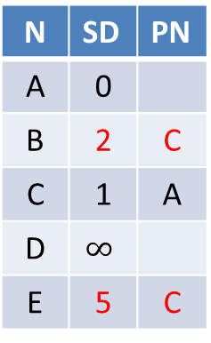
Visit Node C
2
∞
3
N | SD | PN
A | 0
B | 2 | C
C | 1 | A
D | $$∞$$
E | 5 | C
B
D
3
0
1
A
1
2
1
1
C
E
5
4

Slide 30
Visit Node B
2
5
3
N | SD | PN
A | 0
B | 2 | C
C | 1 | A
D | 5 | B
E | 3 | B
B
D
3
0
1
A
1
2
1
1
C
E
3
4

Slide 31
Visit Node E
2
5
3
B
D
N | SD | PN
A | 0
B | 2 | C
C | 1 | A
D | 5 | B
E | 3 | B
3
0
1
A
1
2
1
1
C
E
3
4
Nothing changes

Slide 32
Visit Node D
2
5
3
N | SD | PN
A | 0
B | 2 | C
C | 1 | A
D | 5 | B
E | 3 | B
B
D
3
0
1
A
1
2
1
1
C
E
3
4
Nothing changes

Slide 33
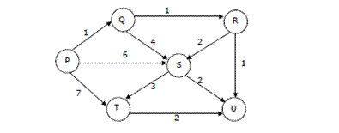
Quiz: Dijstra’s Algorithm
Suppose we run Dijkstra’s single source shortest-path algorithm on the following edge weighted directed graph with vertex P as the source. In what order do the nodes get included into the set of vertices for which the shortest path distances are finalized?
ANS: P, Q, R, U, S, T

Slide 34
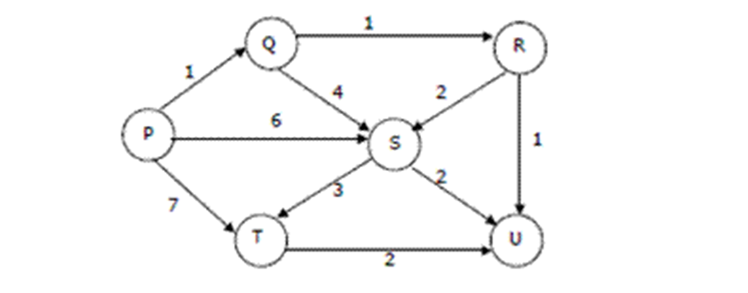
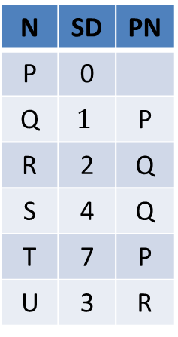
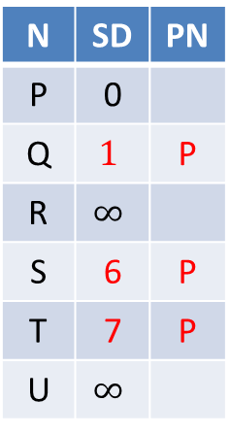

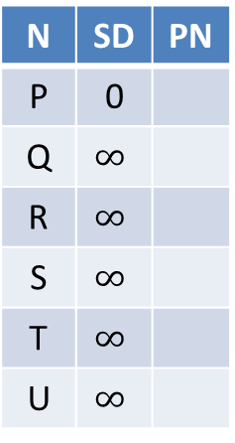
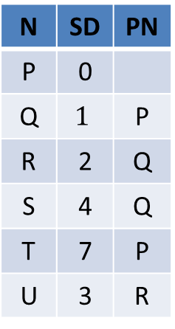
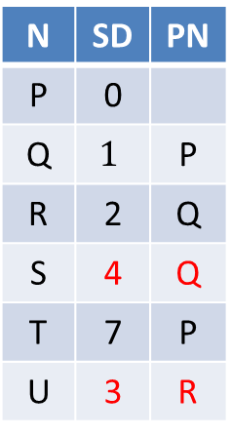
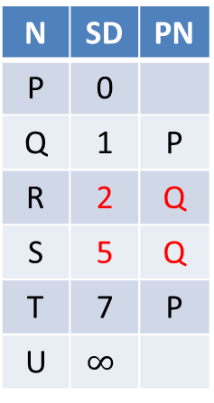
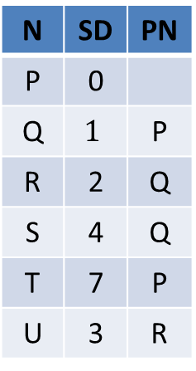
SD: Shortest Distance
PN: Previous Node
N | SD | PN
P | 0
Q | $$∞$$
R | $$∞$$
S | $$∞$$
T | $$∞$$
U | $$∞$$
N | SD | PN
P | 0
Q | $$1$$ | P
R | $$∞$$
S | 6 | P
T | 7 | P
U | $$∞$$
N | SD | PN
P | 0
Q | 1 | P
R | 2 | Q
S | 5 | Q
T | 7 | P
U | $$∞$$
N | SD | PN
P | 0
Q | $$1$$ | P
R | 2 | Q
S | 4 | Q
T | 7 | P
U | 3 | R
Visit P
Visit Q
Visit R
Visit U (nothing changes)
N | SD | PN
P | 0
Q | $$1$$ | P
R | 2 | Q
S | 4 | Q
T | 7 | P
U | 3 | R
N | SD | PN
P | 0
Q | $$1$$ | P
R | 2 | Q
S | 4 | Q
T | 7 | P
U | 3 | R
N | SD | PN
P | 0
Q | $$1$$ | P
R | 2 | Q
S | 4 | Q
T | 7 | P
U | 3 | R
N | SD | PN
P | 0
Q | $$1$$ | P
R | 2 | Q
S | 4 | Q
T | 7 | P
U | 3 | R
Visit S
Visit T
Finished
(nothing
changes)
(nothing
changes)

Slide 35
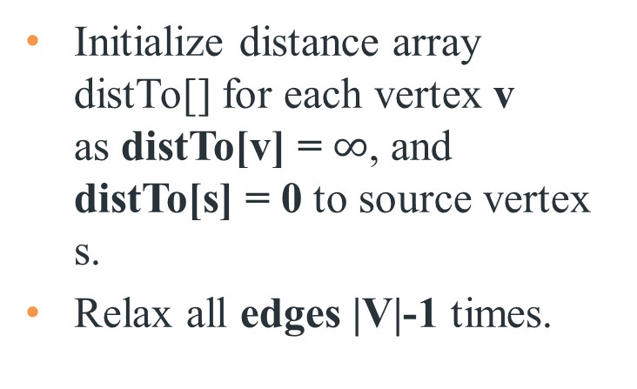
Bellman-Ford Algorithm
Initialize distance array distTo[] for each vertex v as distTo[v] = $∞$, and distTo[s] = 0 to source vertex s.
Relax all edges |V|-1 times.
Recall:
Generic algorithm (to compute SPT from s)
For each vertex v: distTo[v] = ∞.
For each vertex v: edgeTo[v] = null.
distTo[s] = 0.
Repeat until done:
- Relax any edge.
private void relax(DirectedEdge e)
{
int v = e.from(), w = e.to();
if (distTo[w] > distTo[v] + e.weight())
{
distTo[w] = distTo[v] + e.weight();
edgeTo[w] = e;
}
}
Bellman–Ford algorithm
For each vertex v: distTo[v] = ∞.
For each vertex v: edgeTo[v] = null.
distTo[s] = 0.
Repeat |V | -1 times:
- Relax each edge.
Notes:
Now, Relax all the edges one more time i.e. the Nth time and based on the below two cases we can detect the negative cycle:
Case 1 (Negative cycle exists): For any edge(u, v, weight), if dist[u] + weight < dist[v]
Case 2 (No Negative cycle) : case 1 fails for all the edges.
Initialize distance array dist[] for each vertex ‘v‘ as dist[v] = INFINITY.
Assume any vertex (let’s say ‘0’) as source and assign dist = 0.
Relax all the edges(u,v,weight) N-1 times as per the below condition:
dist[v] = minimum(dist[v], distance[u] + weight)
Now, Relax all the edges one more time i.e. the Nth time and based on the below two cases we can detect the negative cycle:
Case 1 (Negative cycle exists): For any edge(u, v, weight), if dist[u] + weight < dist[v]
Case 2 (No Negative cycle) : case 1 fails for all the edges.

Slide 36
Bellman-Ford Algorithm Proof of Correctness
Relaxing edges |V|-1 times in the Bellman-Ford Algorithm guarantees that the algorithm has explored all possible paths of length up to |V|-1, which is the maximum possible length of a shortest path in a graph with |V| vertices. This allows the algorithm to correctly calculate the shortest paths from the source vertex to all other vertices, given that there are no negative-weight cycles.

Slide 37
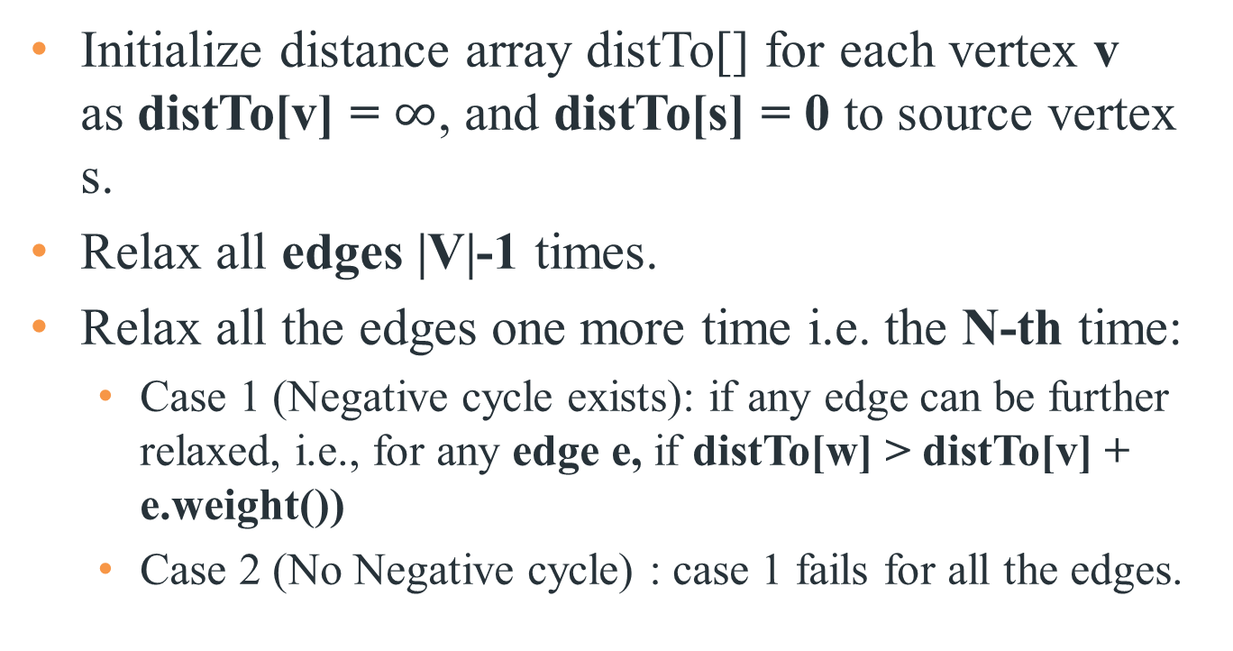
Bellman-Ford Algorithm with Negative Cycle Detection
Initialize distance array distTo[] for each vertex v as distTo[v] = $∞$, and distTo[s] = 0 to source vertex s.
Relax all edges |V|-1 times.
Relax all the edges one more time i.e. the N-th time:
Case 1 (Negative cycle exists): if any edge can be further relaxed, i.e., for any edge e, if distTo[w] > distTo[v] + e.weight())
Case 2 (No Negative cycle) : case 1 fails for all the edges.
Notes:
Initialize distance array dist[] for each vertex ‘v‘ as dist[v] = INFINITY.
Assume any vertex (let’s say ‘0’) as source and assign dist = 0.
Relax all the edges(u,v,weight) N-1 times as per the below condition:
dist[v] = minimum(dist[v], distance[u] + weight)
Now, Relax all the edges one more time i.e. the Nth time and based on the below two cases we can detect the negative cycle:
Case 1 (Negative cycle exists): For any edge(u, v, weight), if dist[u] + weight < dist[v]
Case 2 (No Negative cycle) : case 1 fails for all the edges.

Slide 38
Time Complexity of Bellman-Ford Algorithm
Time complexity for connected graph:
Best Case: O(|E|), when distance array after 1st and 2nd relaxation are same , we can simply stop further processing after one iteration
Average Case: O(|V|*|E|)
Worst Case: O(|V|*|E|)
If the graph is complete, the value of E becomes O(|V|²). So overall time complexity becomes O(|V|³)
Notes:
What is the time complexity of Bellman-Ford single-source shortest path algorithm on a complete graph of n vertices?
ANS: O(V3)
Time complexity of Bellman-Ford Algorithm Example 1 is O(VE) where V is number of vertices and E is number edges . If the graph is complete, the value of E becomes O(V2). So overall time complexity becomes O(V3)

Slide 39
Bellman-Ford Algorithm Example 1
0
∞
10
S
A
Iteration: 0
8
1
∞
∞
G
-4
B
2
1
1
-2
C
∞
F
∞
-1
3
E
D
-1
∞
∞

Slide 40
Bellman-Ford Algorithm Example 1
0
10
10
S
A
Iteration: 1
8
1
∞
8
G
-4
B
2
1
1
-2
C
∞
F
∞
-1
3
E
D
-1
∞
∞

Slide 41
Bellman-Ford Algorithm Example 1
0
10
10
S
A
Iteration: 2
8
1
∞
8
G
-4
B
2
1
1
-2
C
∞
F
9
-1
3
E
D
-1
12
∞

Slide 42
Bellman-Ford Algorithm Example 1
0
5
10
S
A
Iteration: 3
8
1
10
8
G
-4
B
A has the correct distance and path
2
1
1
-2
C
∞
F
9
-1
3
E
D
-1
8
∞

Slide 43
Bellman-Ford Algorithm Example 1
0
5
10
S
A
Iteration: 4
8
1
6
8
G
-4
B
2
1
1
-2
C
11
F
9
-1
3
E
D
-1
7
∞

Slide 44
Bellman-Ford Algorithm Example 1
0
5
10
S
A
Iteration: 5
8
1
5
8
G
-4
B
B has the correct distance and path
2
1
1
-2
C
7
F
9
-1
3
E
D
-1
7
14

Slide 45
Bellman-Ford Algorithm Example 1
0
5
10
S
A
Iteration: 6
8
1
5
8
G
-4
B
2
1
1
-2
C
6
F
9
-1
3
E
D
-1
7
10

Slide 46
Bellman-Ford Algorithm Example 1
0
5
10
S
A
Iteration: 7
8
1
5
8
G
-4
B
D (and all other nodes) have the correct distance and path
2
1
1
-2
C
6
F
9
-1
3
E
D
-1
7
9

Slide 47
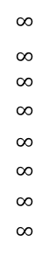
Bellman-Ford Algorithm Example 2
Repeat V − 1 times: relax all E edges.
v distTo[]
0
1
2
3
4
5
6
7
$$∞$$
$∞$ $∞$
$$∞$$
$$∞$$
$$∞$$
$$∞$$
$$∞$$
0
5
17
20
9
13
28
8
14
17
26
25
1
15
3
5
4
12
0
3
8
7
2
7
9
v edgeTo[]
9
5
6
1
0
1
2
3
4
5
6
7
-
-
-
-
-
-
-
-
0
1
1
0
4
2
0
5
2
5
2
5
11
4
4
13
20
6
pass 1
pass 2
pass 3
(no further changes)
pass 4-7 (no further changes)
0→1 0→4 0→7 1→2 1→3 1→7 2→3 2→6 3→6 4→5 4→6 4→7 5→2 5→6 7→2 7→5

Slide 48
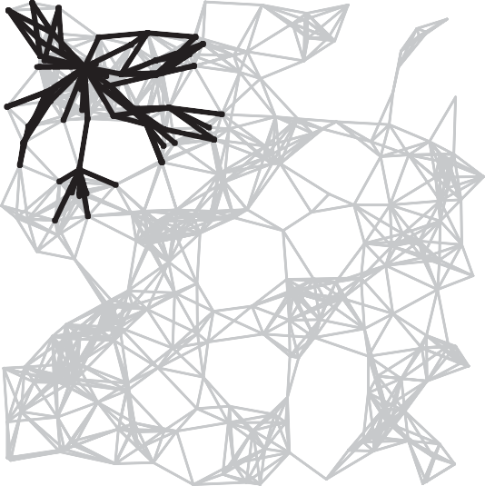
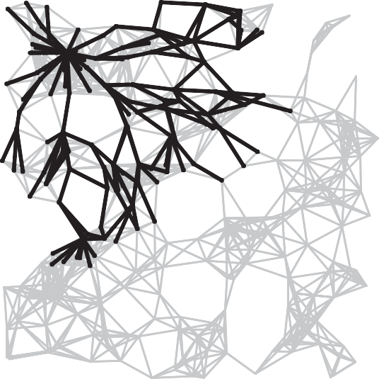
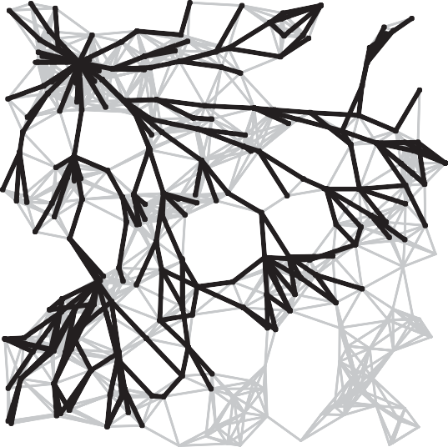
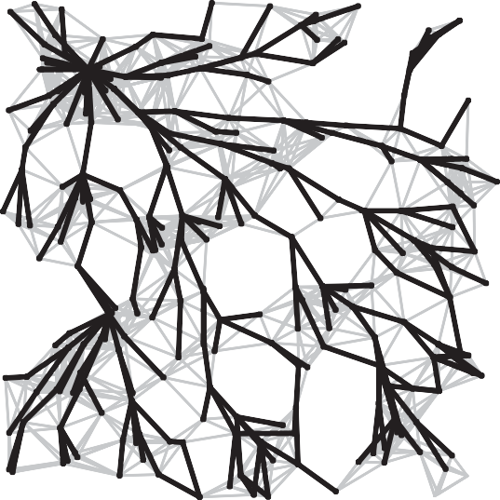
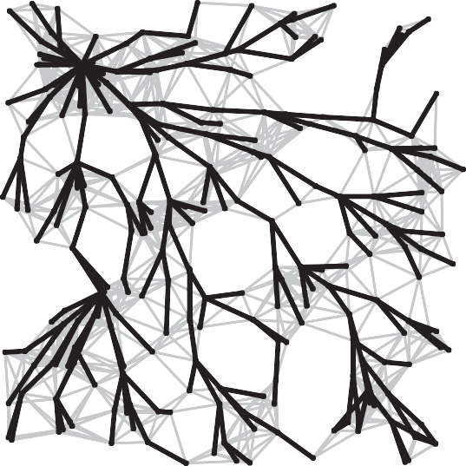
Bellman-Ford Algorithm Visualization
passes 4
7
10
13
SPT

Slide 49
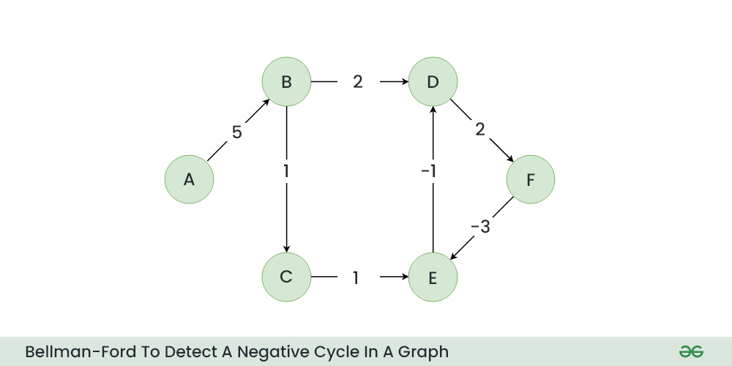
Bellman-Ford Algorithm Example 3 w. Negative Cycle

Slide 50
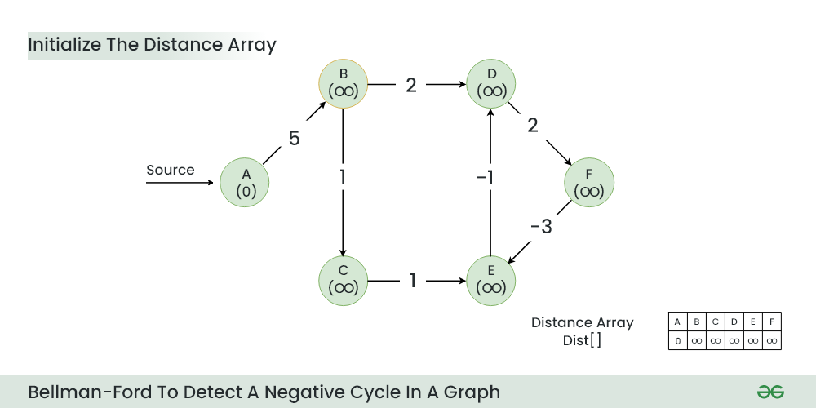
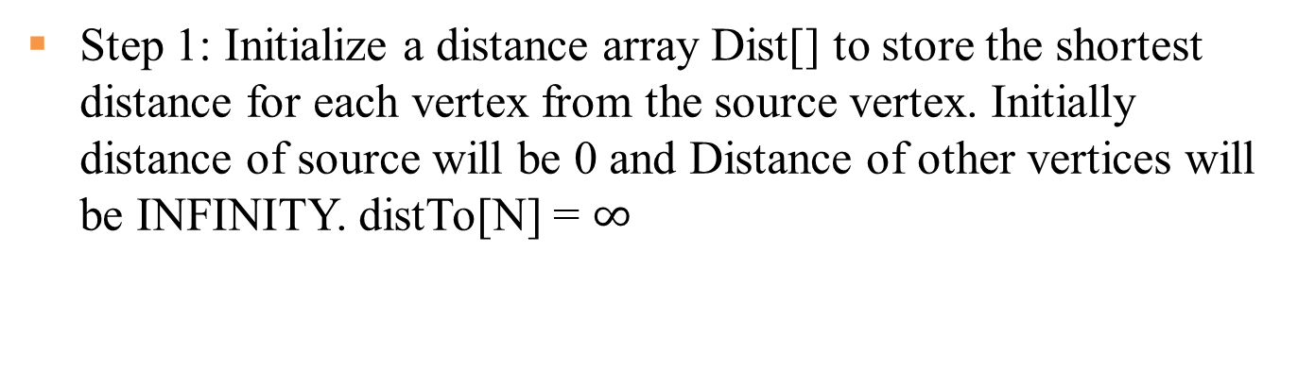
Step 1: Initialize a distance array Dist[] to store the shortest distance for each vertex from the source vertex. Initially distance of source will be 0 and Distance of other vertices will be INFINITY. distTo[N] = $∞$

Slide 51
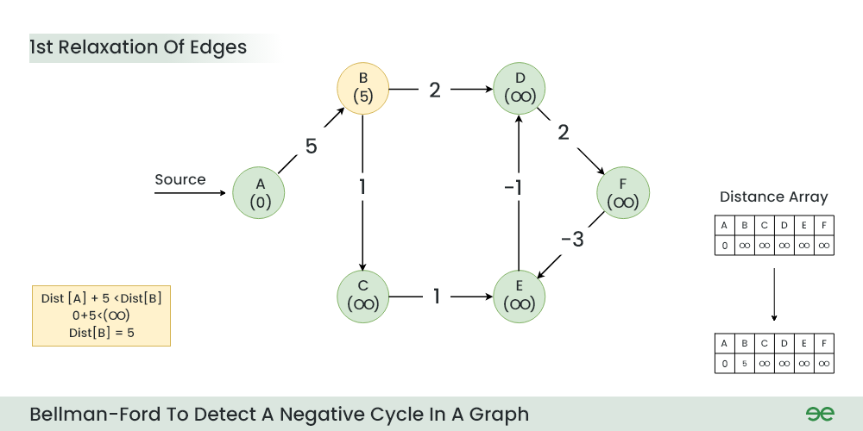
Step 2: Start relaxing the edges, during 1st relaxation:
OLD distTo[B] = ∞ > distTo[A] + e[A][B].weight() = 0+5 = 5
NEW distTo[B] = distTo[A] + e[A][B].weight() = 5

Slide 52
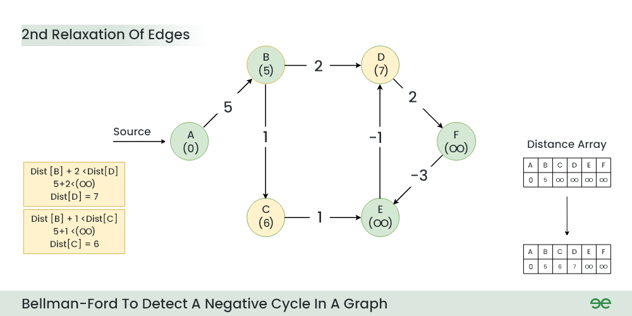
Step 3: During 2nd relaxation:
OLD distTo[D] = ∞ > distTo[B] + e[B][D].weight() = 5+2 = 7
NEW distTo[D] ← distTo[B] + e[B][D].weight() = 7
OLD distTo[C] = ∞ > distTo[B] + e[B][C].weight() = 5+1 = 6
NEW distTo[C] ← distTo[B] + e[B][C].weight() = 6

Slide 53
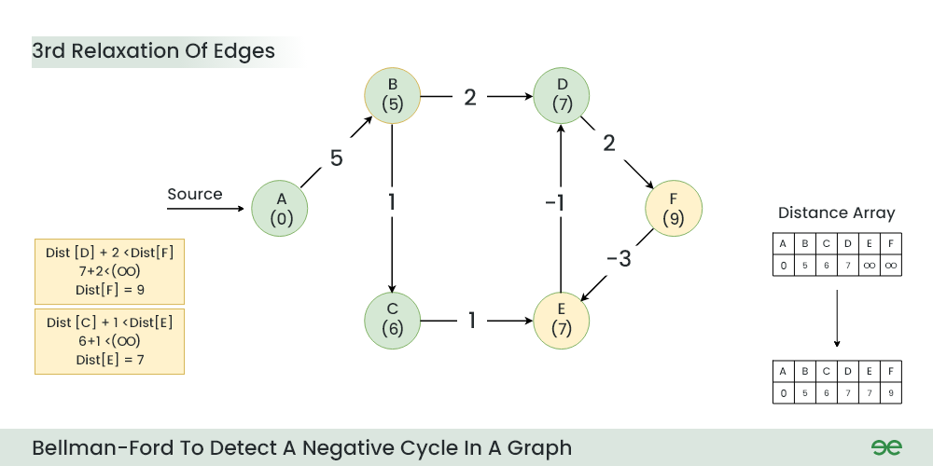
Step 4: During 3rd relaxation:
OLD distTo[F] = ∞ > distTo[D] + e[D][F].weight() = 7+2 = 9
NEW distTo[F] ← distTo[D] + e[D][F].weight() = 9
OLD distTo[E] = ∞ > distTo[C] + e[C][E].weight() = 6+1 = 7
NEW distTo[E] ← distTo[C] + e[C][E].weight() = 7
Notes:
Current Distance of F > (Distance of D ) + (Weight of D to F) i.e. Infinity > 7 + 2
Dist[F] = 9
Current Distance of E > (Distance of C ) + (Weight of C to E) i.e. Infinity > 6 + 1
Dist[E] = 7

Slide 54
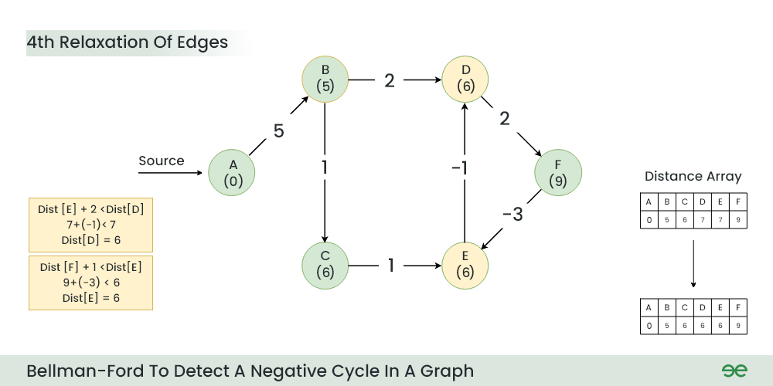
Step 5: During 4th relaxation:
OLD distTo[D] = 7 > distTo[E] + e[E][D].weight() = 7-1 = 6
NEW distTo[D] ← distTo[E] + e[E][D].weight() = 6
OLD distTo[E] = 7 > distTo[F] + e[F][E].weight() = 9-3 = 6
NEW distTo[E] ← distTo[F] + e[F][E].weight() = 6
Notes:
Current Distance of D > (Distance of E) + (Weight of E to D) i.e. 7 > 7 + (-1)
Dist[D] = 6
Current Distance of E > (Distance of F ) + (Weight of F to E) i.e. 7 > 9 + (-3)
Dist[E] = 6

Slide 55
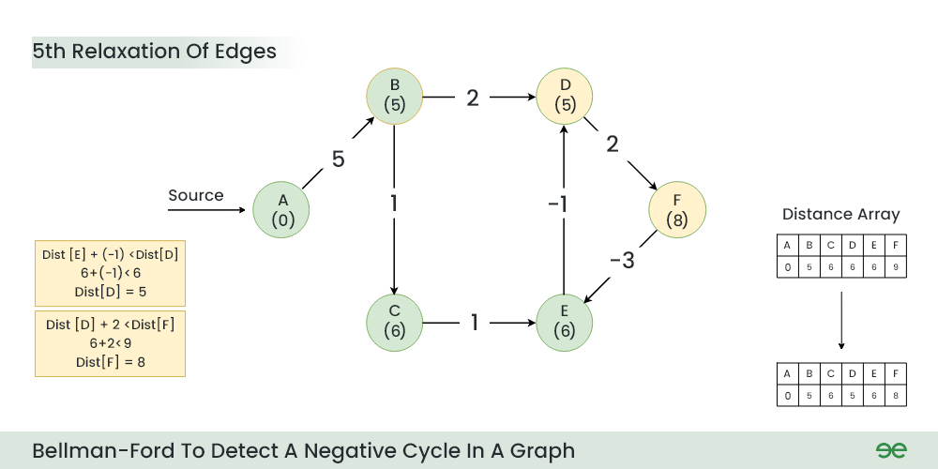
Step 6: During 5th relaxation:
OLD distTo[F] = 9 > distTo[D] + e[D][F].weight() = 6+2 = 8
NEW distTo[D] ← distTo[D] + e[D][F].weight() = 8
OLD distTo[D] = 6 > distTo[E] + e[E][D].weight() = 6-1 = 5
NEW distTo[E] ← distTo[E] + e[E][D].weight() = 5
Since the graph h 6 vertices, So during the 5th relaxation the shortest distance for all the vertices should have been calculated.
Notes:
Current Distance of F > (Distance of D) + (Weight of D to F) i.e. 9 > 6 + 2
Dist[F] = 8
Current Distance of D > (Distance of E ) + (Weight of E to D) i.e. 6 > 6 + (-1)
Dist[D] = 5

Slide 56
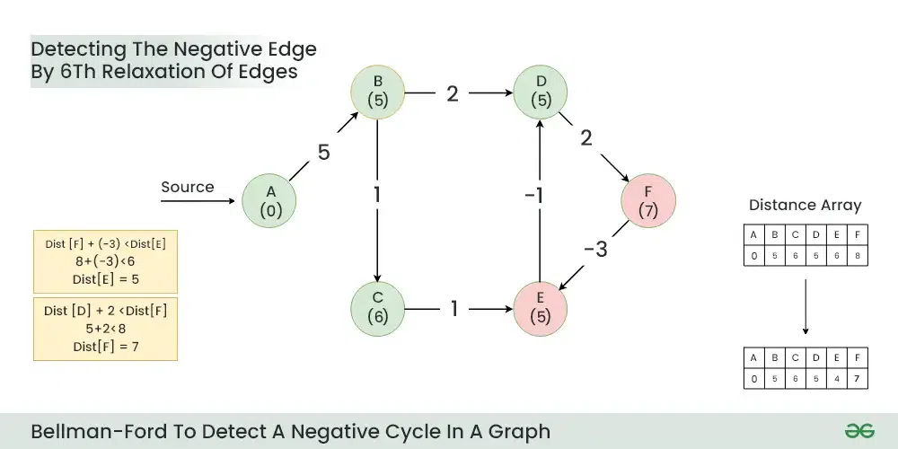
Step 7: Now the final relaxation i.e. the 6th relaxation should indicate the presence of negative cycle if there is any changes in the distance array of 5th relaxation.
During the 6th relaxation, following changes can be seen:
OLD distTo[E] = 6 > distTo[F] + e[F][E].weight() = 8-3 = 5
NEW distTo[D] ← distTo[F] + e[F][E].weight() = 5
OLD distTo[F] = 8 > distTo[D] + e[D][F].weight() = 5+2 = 7
NEW distTo[E] ← distTo[D] + e[D][F].weight() = 7
Since, we observer changes in the Distance array. Hence ,we can conclude the presence of a negative cycle in the graph (D->F->E).
Notes:
Current Distance of E > (Distance of F) + (Weight of F to E) i.e. 6 > 8 + (-3)
Dist[E]=5
Current Distance of F > (Distance of D ) + (Weight of D to F) i.e. 8 > 5 + 2
Dist[F]=7

Slide 57
Dijkstra's Algorithm vs. Bellman-Ford Algorithm
Dijkstra's Algorithm:
Uses a priority queue to select the next vertex to process.
Greedily selects the vertex with the smallest tentative distance to source node.
Works only on graphs with non-negative edge weights.
Time complexity of O(V^2) for a dense graph and O(E log V) for a sparse graph.
Bellman-Ford Algorithm:
Iteratively relaxes all edges V-1 times, where V is the number of vertices.
Does not use a priority queue.
Can handle graphs with negative edge weights, and can detect negative cycles.
Time complexity of O(VE), where V is the number of vertices and E is the number of edges in the graph.
Dijkstra's algorithm is faster and more efficient for graphs with non-negative weights, the Bellman-Ford Algorithm Example 1 is more versatile as it can handle negative weights and detect negative cycles, albeit at the cost of lower efficiency.
Notes:
Dijkstra's Algorithm:
- Finds the shortest path from a single source vertex to all other vertices in a graph with non-negative edge weights.
**Bellman-Ford Algorithm:**
- Finds the shortest path from a single source vertex to all other vertices in a graph, even with negative edge weights.
- Can detect negative cycles in the graph.
## Edge Weight Handling
**Dijkstra's Algorithm:**
- Works only on graphs with non-negative edge weights.
**Bellman-Ford Algorithm:**
- Can handle graphs with negative edge weights.
- Can detect negative cycles.
## Performance
Dijkstra's Algorithm:
- More efficient for graphs with non-negative weights.
- Time complexity: O(V log V + E) with a binary heap implementation, where V is the number of vertices and E is the number of edges.
**Bellman-Ford Algorithm:**
- Generally slower than Dijkstra's.
- Time complexity: O(VE), where V is the number of vertices and E is the number of edges.
## Implementation

Slide 58
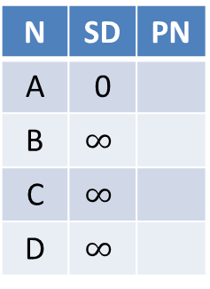
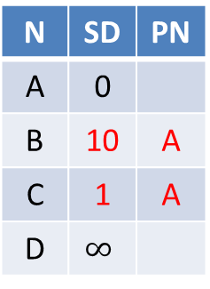
Dijkstra’s Algorithm does not work for Negative Edge Weights
Dijkstra’s Algorithm is greedy and optimal: any node that has been visited should have its shortest distance to the source. After visiting A, C, D, we have got D’s shortest distance to A is 2, but after visiting D, D’s distance to A is updated to -10, which violates the greedy optimal assumption of Dijkstra’s Algorithm.
N | SD | PN
A | 0
B | $$∞$$
C | $$∞$$
D | $$∞$$
N | SD | PN
A | 0
B | 10 | A
C | 1 | A
D | $$∞$$
N | SD | PN
A | 0
B | 10 | A
C | 1 | A
D | 2 | C
N | SD | PN
A | 0
B | 10 | A
C | 1 | A
D | 2 | C
Visit A
Visit C
Visit D
Visit B
B
N | SD | PN
A | 0
B | 10 | A
C | 1 | A
D | -10 | B
10
-20
A
D
Incorrect
1
1
C
Notes:
Run Dijkstra’s algorithm on this graph, starting from node A. Run it anyway.
• A → B: 10
• A → C: 1
• B → D: -20
• C → D: 1
Since Dijkstra’s Algorithm is a greedy algorithm, it visits A, C, D, then finishes. I

Slide 59

Bellman Ford Algorithm works for Negative Edge Weights
We run for V-1=3 iterations, then run one more iteration with no change. Hence we conclude that The Bellman-Ford algorithm successfully calculated the shortest paths from node A to all other nodes. The shortest path from node A to node D goes through node B with a total cost of -10. There are no negative weight cycles.
N | SD | PN
A | 0
B | $$∞$$
C | $$∞$$
D | $$∞$$
N | SD | PN
A | 0
B | 10 | A
C | 1 | A
D | -10 | B
N | SD | PN
A | 0
B | 10 | A
C | 1 | A
D | -10 | B
N | SD | PN
A | 0
B | 10 | A
C | 1 | A
D | -10 | B
Iter 1
Iter 2
Iter 3
No change
No change
Iter 4
No change
B
N | SD | PN
A | 0
B | 10 | A
C | 1 | A
D | -10 | B
10
-20
A
D
1
1
C

Slide 60
Quiz
Which of the following algorithm can be used to efficiently calculate single source shortest paths in a Directed Acyclic Graph?
Dijkstra
Bellman-Ford
Topological Sort
Strongly Connected Component
ANS: Topological Sort
Using Topological Sort, we can find single source shortest paths in O(V+E) time which is the most efficient algorithm

Slide 61
Quiz
Given a graph where all edges have positive weights, the shortest paths produced by Dijsktra and Bellman Ford algorithm may be different but path weight would always be same.
ANS: True
Dijkstra and Bellman-Ford both work fine for a graph with all positive weights, but they are different algorithms and may pick different edges for shortest paths.

Slide 62
Quiz
Match the following
Group A
a) Dijkstra's single shortest path algo
b) Bellmen Ford's single shortest path algo
c) Floyd Warshall's all pair shortest path algo
Group B
p) Dynamic Programming
q) Backtracking
r) Greedy Algorithm
Dijkstra is a greedy algorithm where we pick the minimum distant vertex from not yet finalized vertices. Bellman Ford and Floyd Warshall both are Dynamic Programming algorithms where we build the shortest paths in bottom up manner.

Slide 63
Quiz
Let G be a directed graph whose vertex set is the set of numbers from 1 to 100. There is an edge from a vertex i to a vertex j if either j = i + 1 or j = 3i. The minimum number of edges in a path in G from vertex 1 to vertex 100 is
A. 4 B. 7 C. 23 D. 99
ANS: 7
The task is to find minimum number of edges in a path in G from vertex 1 to vertex 100 such that we can move to either i+1 or 3i from a vertex i.
Since the task is to minimize number of edges, we would prefer to follow 3*i. Let us follow multiple of 3. 1 => 3 => 9 => 27 => 81, now we can't follow multiple of 3 anymore. So we will have to follow i+1. This solution gives a long path.
What if we begin from end, and we reduce by 1 if the value is not multiple of 3, else we divide by 3. 100 => 99 => 33 => 11 => 10 => 9 => 3 => 1
So we need total 7 edges.

